Slide 1
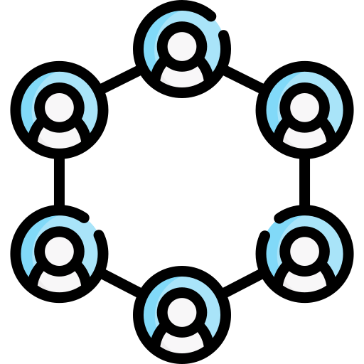
LOTTERY
DECENTRALIZED
Hai Nam Nguyen
Xuan Hieu Nguyen
Cong Chi Tai Nguyen

Slide 2
Agenda
Problem Definition
Architecture
Frontend
Functions
Implementation Process
Demo

Slide 3
Problem Definition
Cyber-attacks, fraud, and manipulation
Security, transaction handling, data privacy, and user experience
Scalability, compliance, mitigating the impact of system failures and ensuring uninterrupted operations

Slide 4
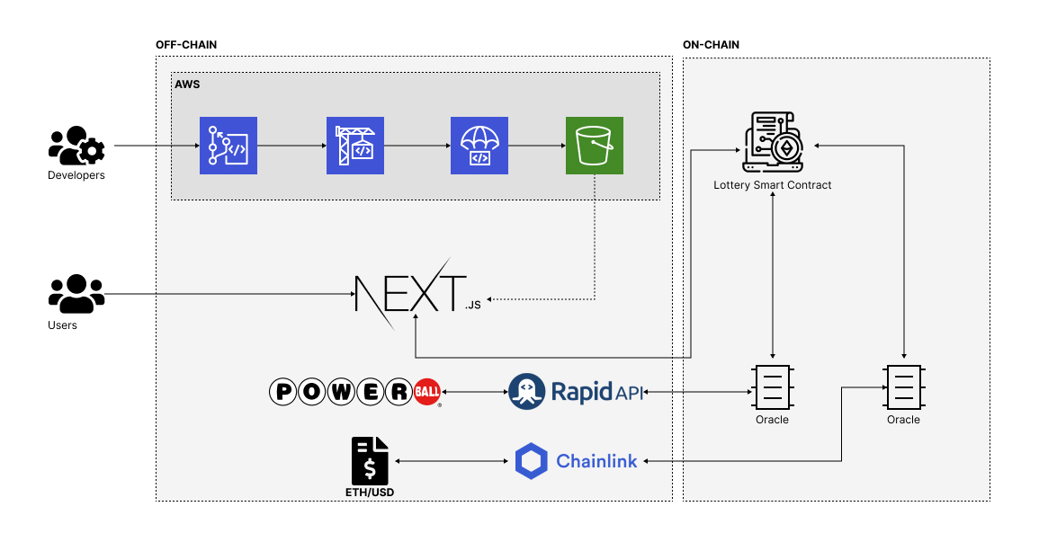
Architecture

Slide 5
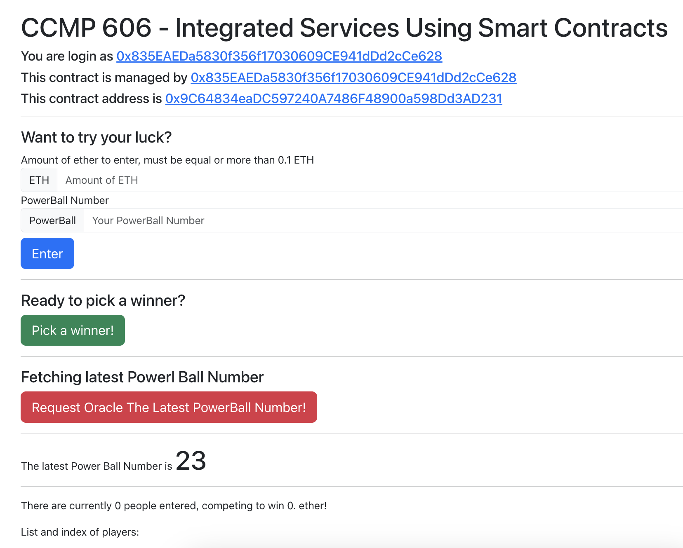
Frontend - Manager

Slide 6
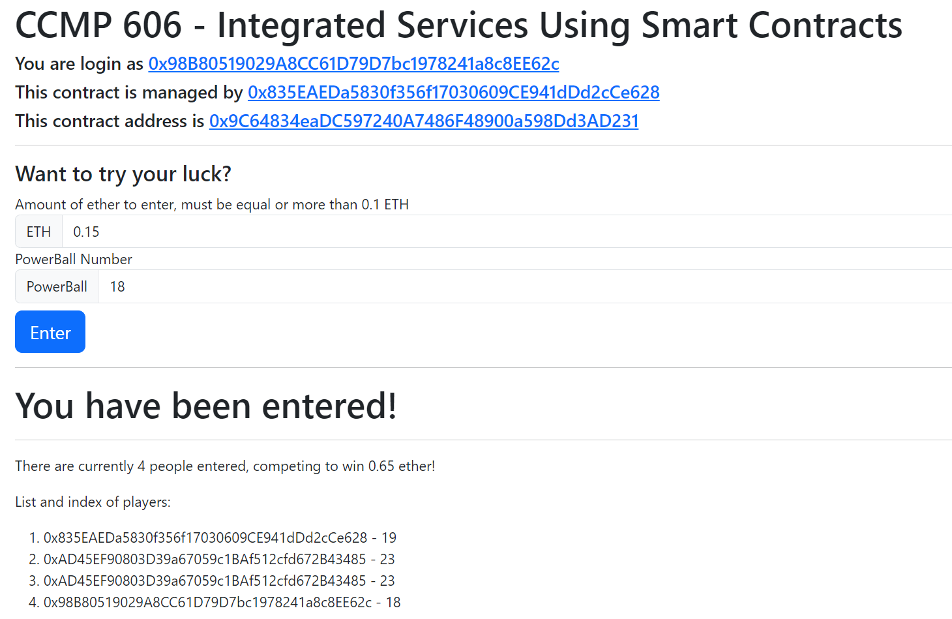
Frontend - Player

Slide 7
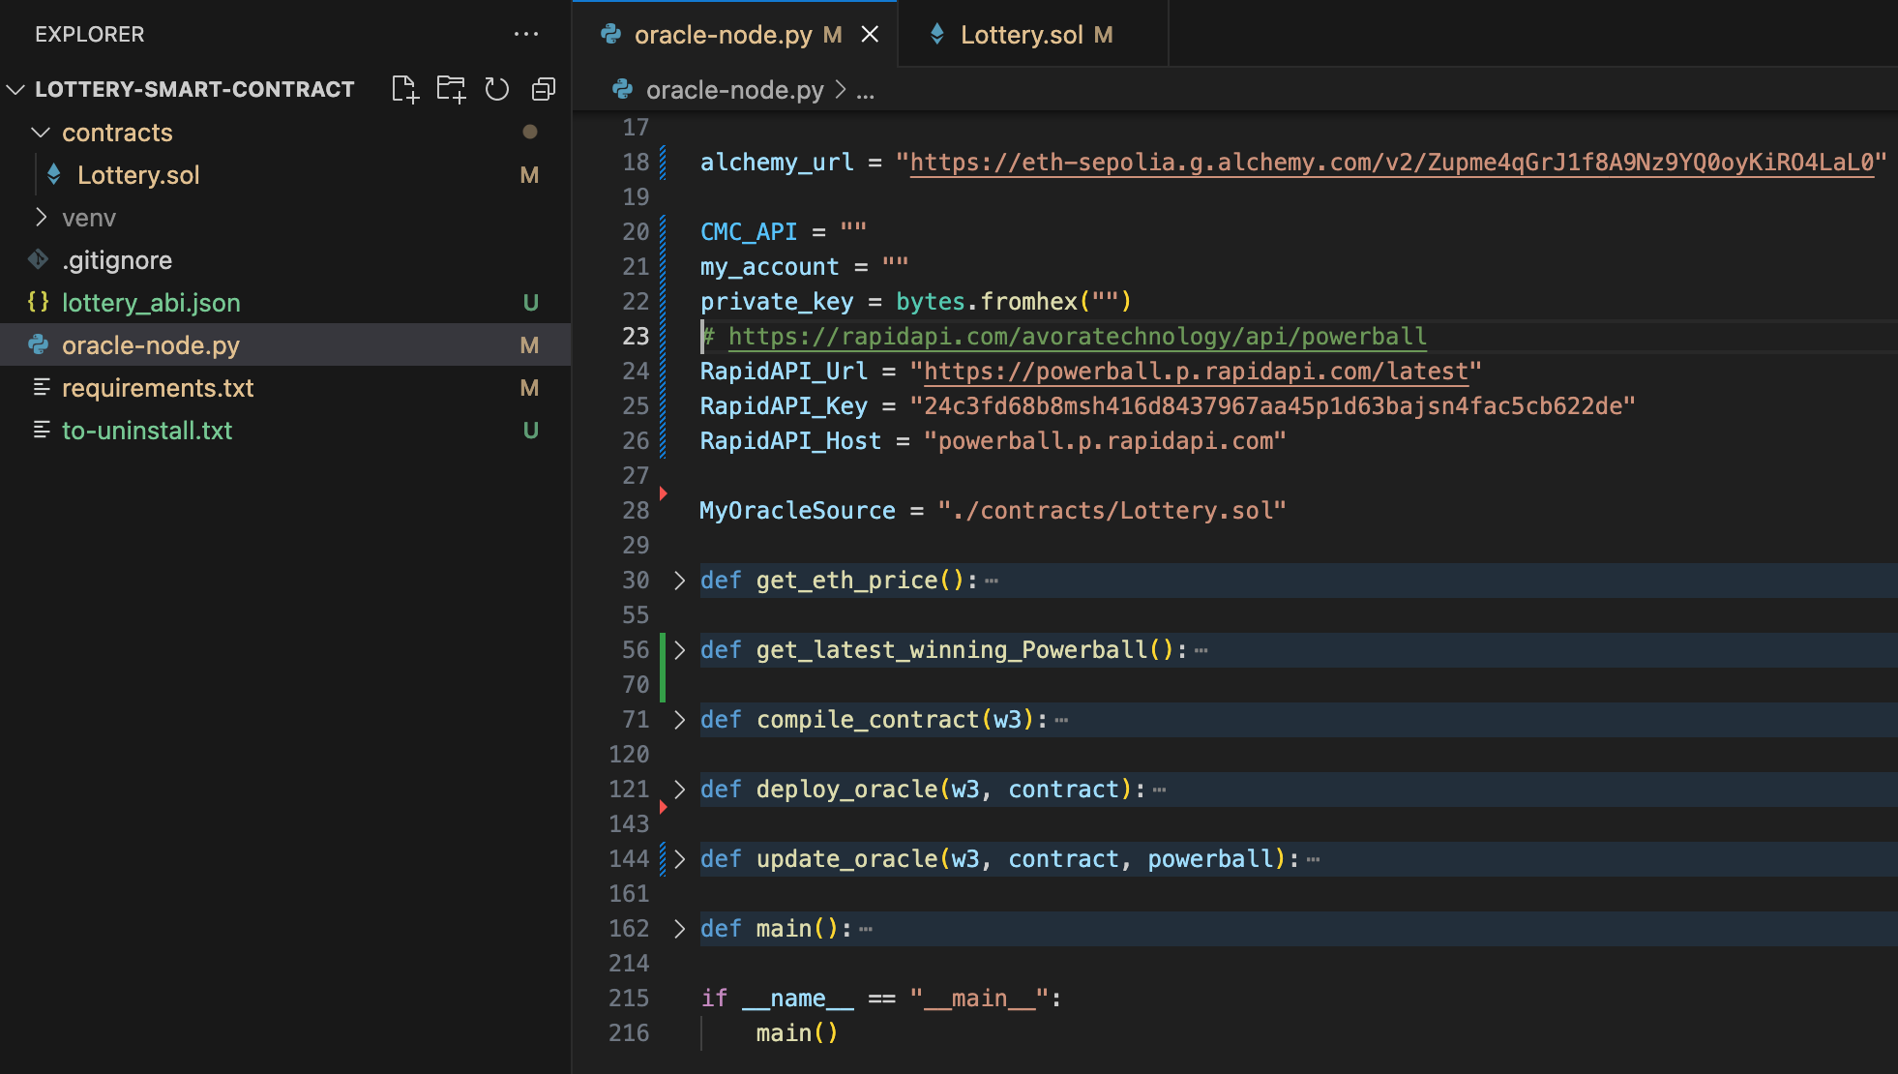
Functions – Oracle-node

Slide 8
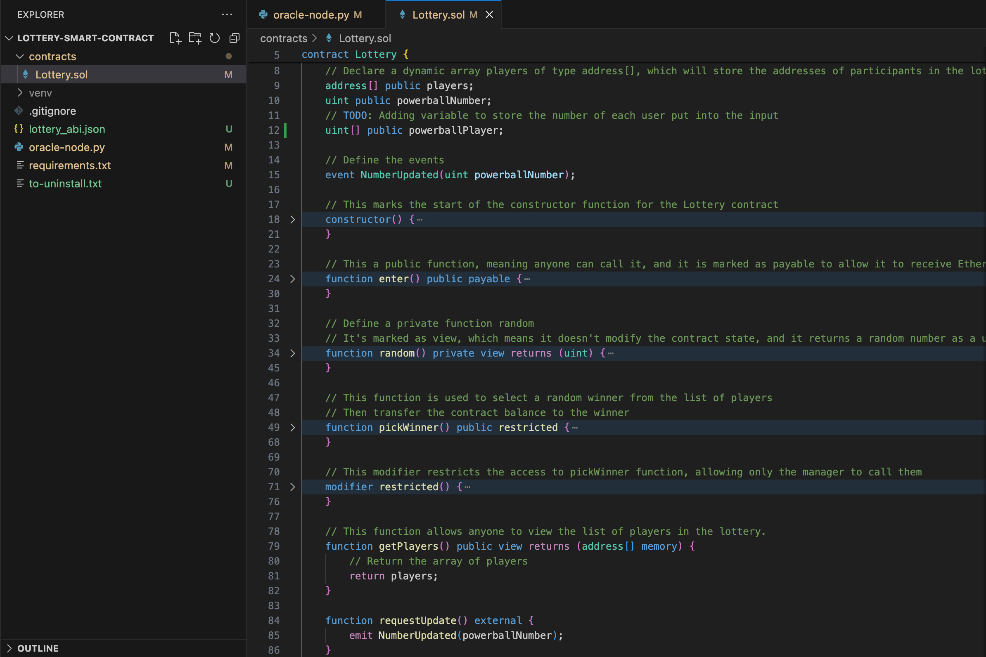
Functions – Smart Contract

Slide 9

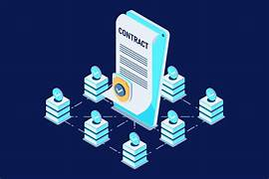


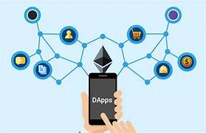
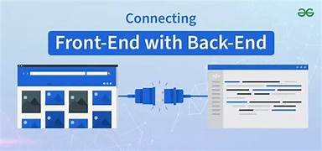
Implementation Process
Define the Concept
Design Smart Contracts
Design Frontend Interface
Test the DApp
Connect Frontend to Blockchain

Slide 10
Demo
Lottery - Dapp

Slide 11
THANK YOU FOR YOUR TIME
Q&A

